Slide 1

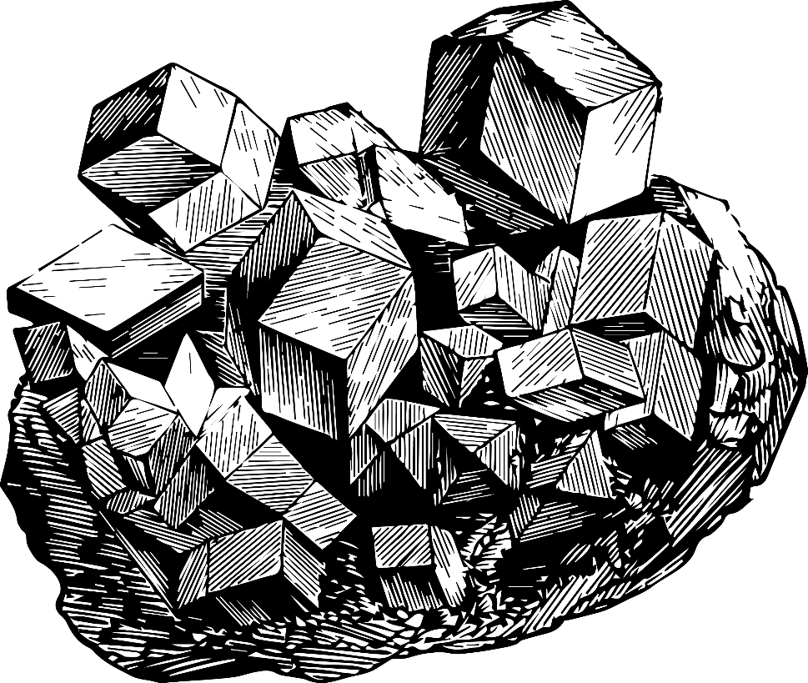





MME 351
Introduction to
Bioleaching

Slide 2
Student ID | Topic
1611037 Introduction
1611038 Microorganisms
1611039 Mechanisms
1611040 Factors
1611041 Techniques
1611042 Industrial Process
1611044 Applications

Slide 3







Presentation Outline
Introduction
Microorganisms
Mechanisms
Factors
Techniques
Industrial Process
Applications

Slide 4
What is Bioleaching?
Bioleaching is a method used for extraction of precious and base metals from low-grade ore with the aid of
bacterial microorganisms

Slide 5
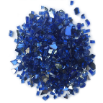

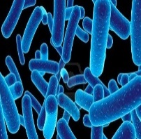

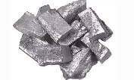
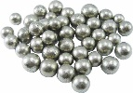





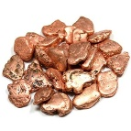

Basic Mechanism
Bioleaching by microorganisms
Pyrometallurgical process
Insoluble metal compounds
Metal dissolved in leaching solution
Pure metals

Slide 6
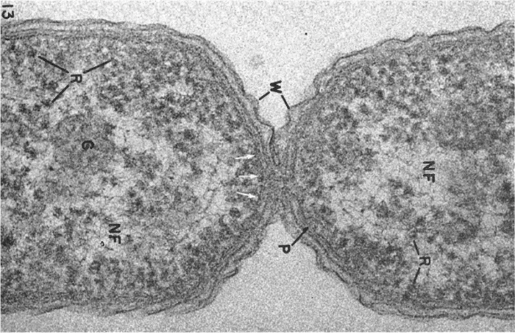
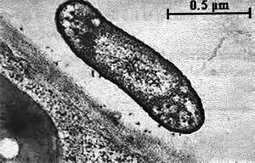
Most Common Microorganisms
Thiobacillus ferrooxidans
Thiobacillus thiooxidans
N. B. This topic will be thoroughly discussed shortly.

Slide 7
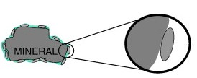
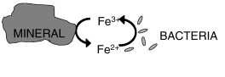
Reaction Mechanisms
Direct Mechanism
Direct contact between bacteria and mineral
Indirect Mechanism
Bacteria not in direct contact with mineral
N. B. This topic will be thoroughly discussed shortly.

Slide 8
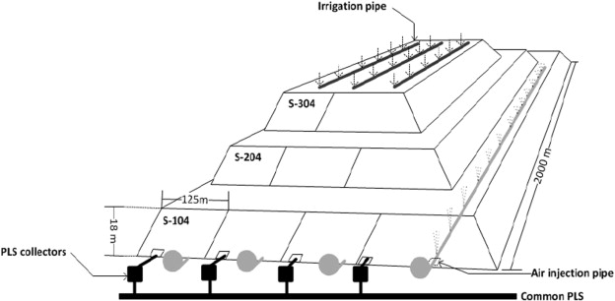
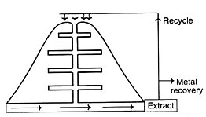
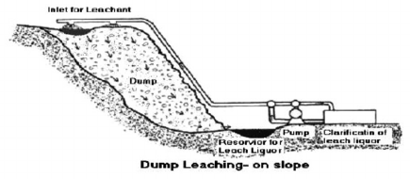
Commercial Processes
Slope Leaching
Heap Leaching
In-situ Leaching
N. B. This topic will be thoroughly discussed shortly.

Slide 9

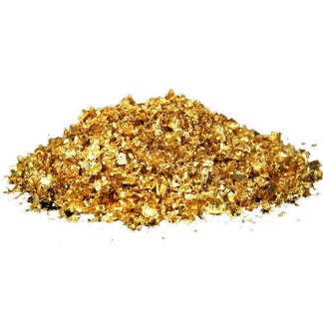
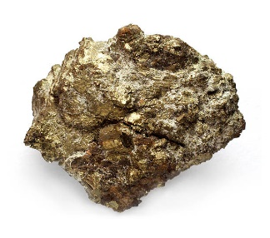
Metals Extracted by Bioleaching
Copper
Gold
Uranium
These three are the most commonly bioleached metals.
Bioleaching other metals are not easy enough to be considered economical.
N. B. This topic will be thoroughly discussed shortly.

Slide 10
Why Consider Bioleaching?
Bioleaching has all the common benefits of hydrometallurgy with added conveniences!
Environmental Advantages: This process is more environment-friendly than traditional methods. No Sulphur-dioxide is produced Less landscape damage occurs, since the bacteria grow naturally, and the mine and surrounding area can be left relatively untouched. As the bacteria breed in the conditions of the mine, they are easily cultivated and recycled.

Slide 11
Why Consider Bioleaching?
Economical Advantages: Bioleaching is in general simpler and, therefore, cheaper to operate and maintain than traditional processes, since fewer specialists are needed to operate complex chemical plants.
Complex Ores: Significant advantage of bioleaching method is found in the pretreatment of refractory gold in ores and concentrates with high arsenic content. This is because, the bacteria tends to attract the arsenic minerals and oxidizes it

Slide 12

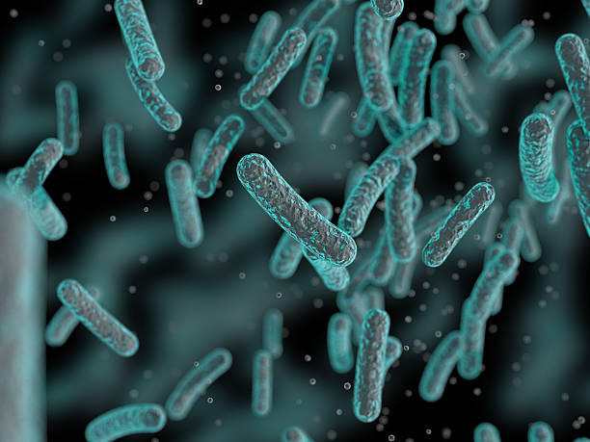
MICROORGANISMS
INVOLVED IN LEACHING

Slide 13

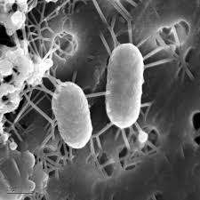
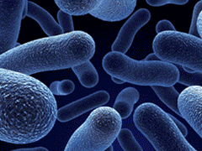
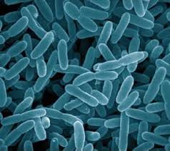
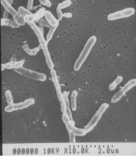
Commonly Used Microorganism:
Thiobacillus ferrooxidans
Thiobacillus thiooxidans
Leptospirillum ferrooxidans
Sulfobacillus spp

Slide 14
Thiobacillus ferrooxidans
Most active in bioleaching
Grow under aerobic conditions
T. ferrooxidans is still able to grow on reduced inorganic sulfur compounds using ferric iron an alternative electron acceptor.
Leaching is carried out at pH value between 1.5 & 3.

Slide 15
Leptospirillum ferrooxidans
Leaching is carried out at lower pH value.
Tolerates high concentration of U, Mo & Ag.
Unable to oxidize sulfurs to sulfur compounds.
Therefore, can only attack mineral sulfides together with Thiobacillus ferrooxidans or Thiobacillus thiooxidans.

Slide 16
Basic Leaching Process:
Ore
Microbes
Soluble metal compounds

Slide 17

What Microorganisms DO?
Microorganisms
Insoluble metal sulfides
soluble metal sulfates

Slide 18

How They Do It?

Slide 19
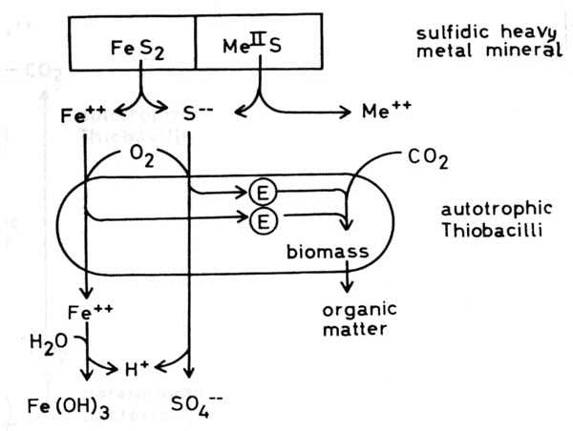
Why They DO it?
Microbes that are used in leaching are Chemolithoautotrophic species.
They use the carbon dioxide of environment and get the required energy from leaching reaction for their metabolic processes.

Slide 20
Classification of bacteria
(According to the temperature in which they are active)
Mesophiles
(30-42 °C)
Moderate Thermophiles
(45-50 °C)
Extreme Thermophiles (65-85 °C)

Slide 21

BIOLEACHING MECHANISMS

Slide 22
BIOLEACHING MECHANISMS
Based on the activity of
T. ferrooxidans
L. ferrooxidans
T. thiooxidans
Convert heavily soluble metal sulfides via bio chemical oxidation reactions into water-soluble metal sulfates

Slide 23
TYPES
Direct bacterial leaching
Indirect bacterial leaching
Metals can be released from sulfide minerals in TWO WAYS

Slide 24
DIRECT BACTERIAL LEACHING
Physical contact between the bacterial cell and the mineral sulfide surface
Oxidation to sulfate takes place via several enzymatically catalyzed steps

Slide 25
Pyrite is oxidized to Iron (III) Sulfate
4FeS₂ + 140₂ + 4H₂0 ^{bacteria} 4 FeSO₄ + 4H₂SO₄
4 FeSO₄ + O₂ + 2H₂SO₄ ^{bacteria} 2Fe₂(SO₄)₃ + 2H₂0
SUMMARISING
4FeS₂ + 150₂ + 2H₂0 ^{bacteria} 2Fe₂(SO₄)₃ + 2H₂SO₄

Slide 26
Non-iron metal sulfides can be oxidized by
T. ferrooxidans in direct interaction
Covellite (CuS)
Galena (PbS)
Molybdenite (MoS₂)
Chalcocite (Cu₂S)
Sphalerite (ZnS)
Stibnite (Sb₂S₃)
Cobaltite (CoS)
Millerite (NiS)
MeS +20₂ ^{bacteria} MeSO₄

Slide 27
Bacteria have to be in intimate contact with the mineral surface
Bacteria do not attach to the whole mineral surface
Prefer specific sites of crystal imperfection
Metal solubilization is due to electrochemical interactions

Slide 28
INDIRECT BACTERIAL LEACHING
Bacteria generate a lixiviant which chemically oxidizes the sulfide mineral
In acid solution this lixiviant is Ferric iron
Metalsolubilization reaction:
MeS + Fe₂(SO₄)₃ MeSO₄ + 2FeSO₄ + S

Slide 29
Chemical oxidation below pH 5.0
The Ferrous iron can be reoxidized to ferric iron by
T. ferrooxidans
Bacteria do not need to be in contact with the mineral surface.
A catalytic function accelerates the reoxidation of ferrous iron which is very slow in the absence of bacteria

Slide 30
In pH 2-3, bacterial oxidation of Ferrous iron is about 105-106 times faster than the chemical oxidation of ferrous iron
The sulfur arising simultaneously may be oxidized to sulfuric acid by T. ferrooxidans
The role of T. thiooxidans in bioleaching consists in creating favorable acid conditions for the growth of ferrous iron oxidizing bacteria such as T.ferrooxidans and L. ferrooxidans

Slide 31
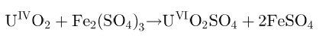
EXAMPLE
Extraction of uranium from ores
Insoluble tetravalent uranium is oxidized to the water-soluble hexavalent stage of uranium
The lixiviant may be generated by T. ferrooxidans by the oxidation of pyrite that is very often associated with uranium ore

Slide 32
CONTROVERSY
Publications by Sand and co-workers
Doubt whether direct leaching mechanism does exist at all
Pyrite is degraded to sulfate via thiosulfate in a cyclic mechanism
The degradation is mediated or at least initiated by the ferric iron being complexed in the exopolymeric compounds of T. ferrooxidans and L. ferrooxidans
These iron(III) ions enable the bacteria to attach to the pyrite surface by an electrochemical mechanism

Slide 33
The function of leaching bacteria
is thought to be in maintaining a high redox potential by keeping the ferric iron in the oxidized state to optimize the indirect attack on the metal sulfide

Slide 34
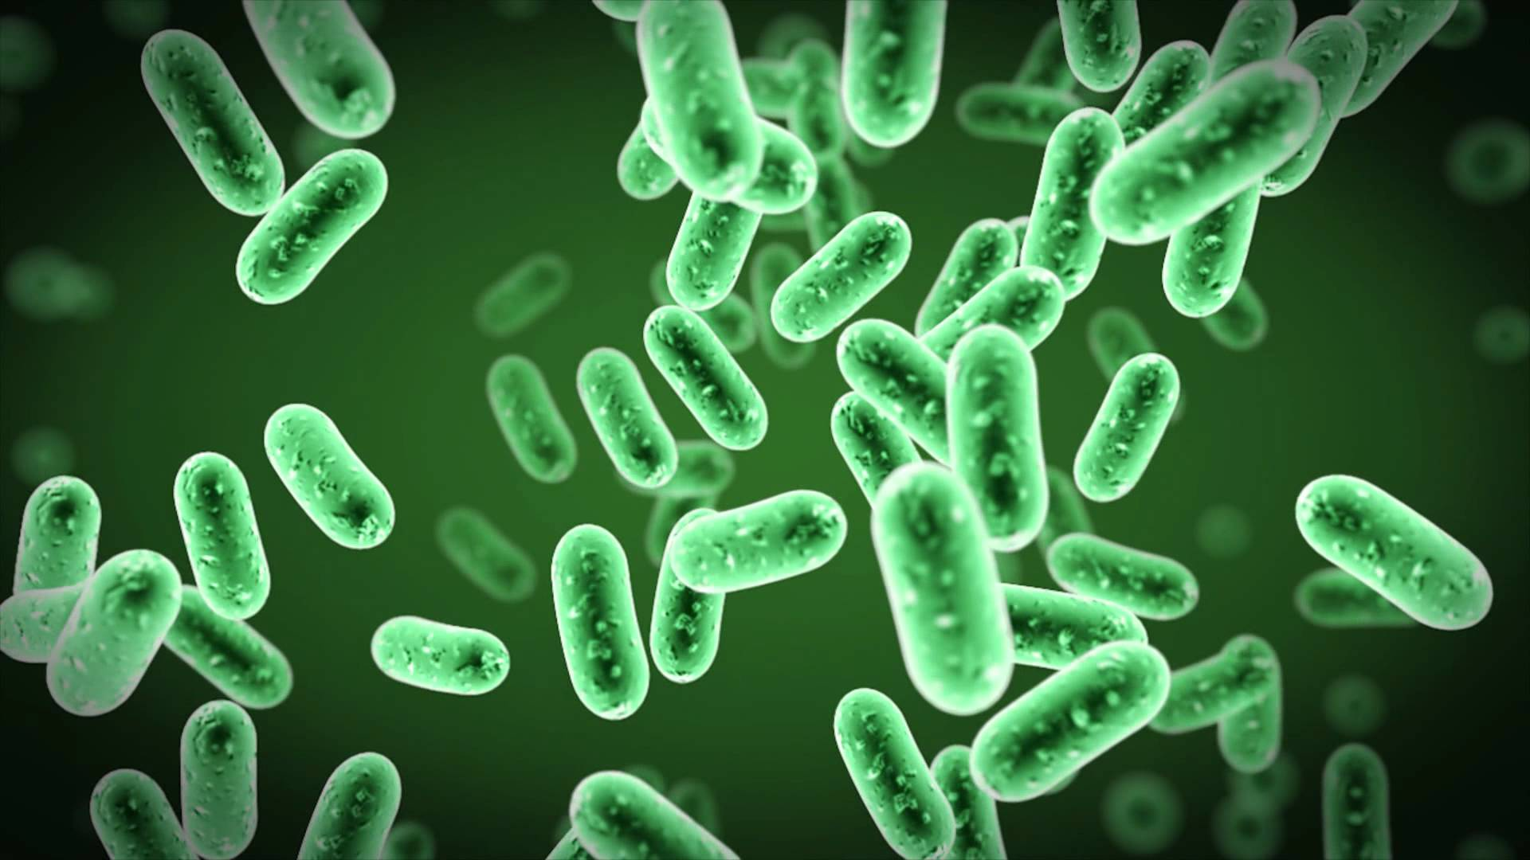
Factors and Parameters Influencing Bioleaching

Slide 35
Factors and Parameters influencing Bioleaching
The leaching effectiveness depends largely on
the efficiency of the micro-organisms and
the chemical and mineralogical composition of the ore to be leached.
The maximum yields of metal extraction can be achieved only when the leaching conditions correspond to the optimum growth conditions of the bacteria.

Slide 36
Factors and Parameters influencing Bioleaching
Factors | Parameters
Physiological | Temperature, light, pressure
 | pH, Redox and water potential
 | Oxygen and Carbon dioxide Content
Microbiological | Microbial diversity
 | Population Diversity
 | Microbial Activities
Properties of Minerals | Mineral size, composition
 | Grain size, porosity
 | Surface area
Processing | Leaching mode
 | pulp density
 | Stirring Rate

Slide 37
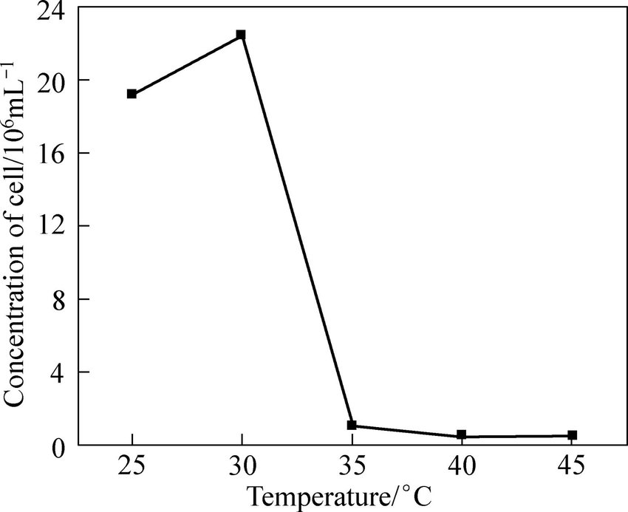
Parameters influencing Bioleaching
1. Temperature
Growth and activity of micro-organisms were influenced by the ambient temperature.
Optimum temperature is required for leaching at a fast rate.
Optimum temperature range for a given bacteria is between 25-35°C depending on the type of ore

Slide 38
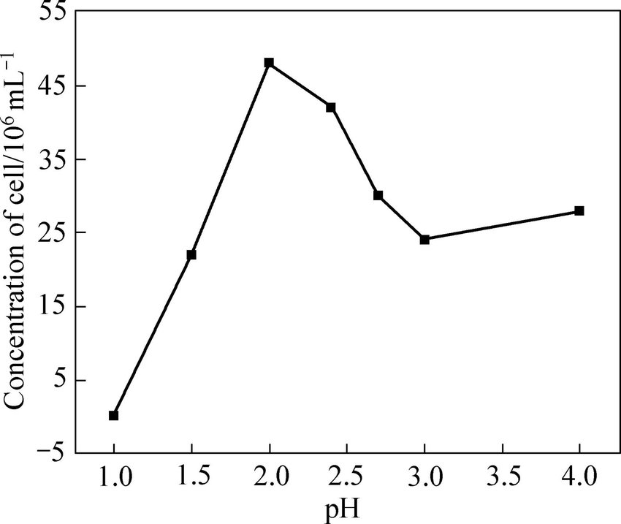
Parameters influencing Bioleaching
2. pH
Bioleaching requires a pH of 1.8-2.5 for maximum results.
The rate of leaching decreases significantly if the pH is not in this range since the activity of bacteria is reduced.

Slide 39
Parameters influencing Bioleaching
3. O₂ And CO₂ content
An adequate supply of oxygen is a prerequisite for good growth and high activity of the leaching bacteria
this can be achieved by aeration, stirring, or shaking
Some types of bacteria depend on carbon dioxide for their supply of carbon
Carbon dioxide is the only carbon source and there is no need for addition of CO₂

Slide 40
Parameters influencing Bioleaching
4.Mineral size and compositions
Rate of oxidation by the bacteria depends on the particle size of the ore.
A optimum particle size varies depending upon ore and bacteria
An enlargement of the total mineral surface area can be obtained by an increase in pulp density
Particle size decrease
Surface area increase
Higher yield of metal

Slide 41
Parameters influencing Bioleaching
4. Mineral size and compositions
Composition of ore such as concentration of sulfides, amount of mineral present, and the extent of contamination, has direct effect on the rate of bio-leaching.
At high carbonate content of the ore the pH in the leaching liquid will increase and bacterial activity will decrease.
Low pH values, necessary for the growth of the leaching bacteria, can be achieved by external addition of acid
this may cause the formation and precipitation of gypsum and will also affect the cost of the process

Slide 42
Parameters influencing Bioleaching
5.Microbial diversity
Leaching using mixed cultures tend to be more robust and efficient than pure
6. Stirring rate
Stirring is also an effective method
to provide continuous air supply uniformly
to mix the contents.

Slide 43


Leaching Techniques

Slide 44


Effectiveness & economy of ‘Bioleaching Process’ depend highly on:
the activity of bacteria
the chemical & mineralogical
composition of ore

Slide 45

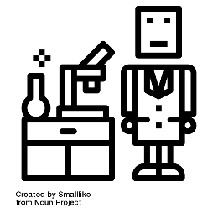
Two Process
Industrial
Leaching
Process
Laboratory
Investigations

Slide 46

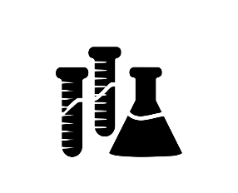
1. Percolator leaching
Laboratory
Investigations
2. Submerged leaching
3. Column leaching

Slide 47
Percolator leaching

Slide 48
The first experiment on bacterial leaching were carried out in air-lift percolators.
Percolator leaching
The percolator consists of a glass tube provided in its bottom part with a sieveplate. (simplest case)

Slide 49

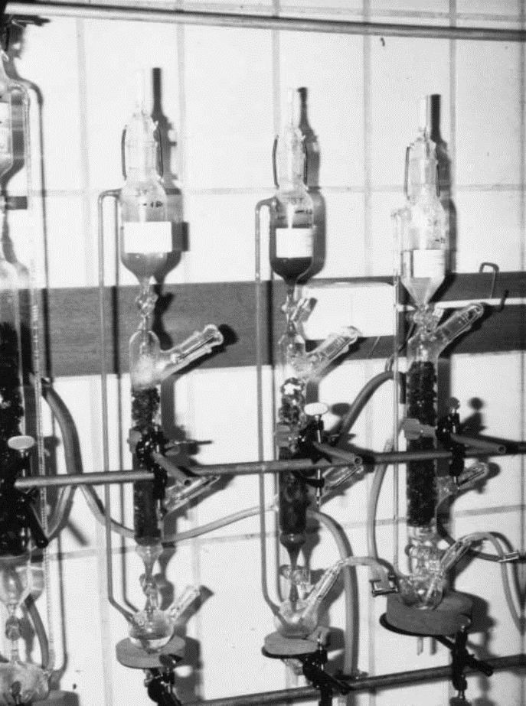

The glass tube is filled with ore particles.
The ore packing irrigated or flooded with a nutrient inoculated with bacteria.
The leach liquor trickling through the column is
pumped up by compressed
sterile air to the top of the
column for recirculation.
Fig. 1:Leaching of low-grade copper ore in air-lift percolators.

Slide 50

Disadvantages
Because
The oxygen supply is inadequate &
The surface ration is unfavorable.
Fairly slow.
PL is not very
efficient

Slide 51
Submerged leaching

Slide 52
Percolator leaching is substantially displaced by submerged leaching.
Use fine grained material
(particle size <100μm).
Submerged leaching
The material is suspended in the leaching liquid and kept in motion by shaking and stirring.
Higher rates of aeration.
Can be carried out in ERLENMEYER FLASKS or in a BIOREACTOR.

Slide 53
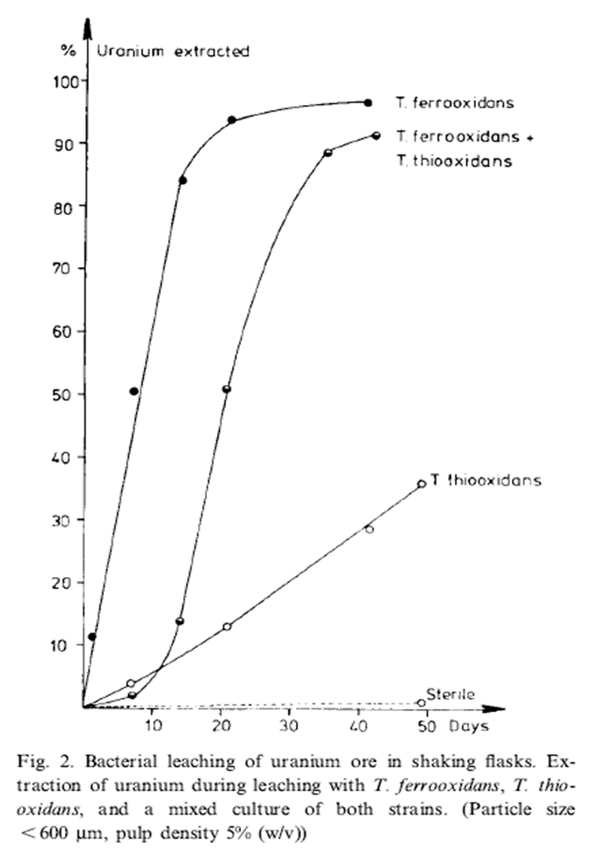
Higher rates of aeration and more accurate monitoring and control of the various parameters favor the growth and the activity of the bacteria.
So that the reaction times are considerably shortened and metal extraction substantially increased. (Fig. 2)

Slide 54
Column leaching

Slide 55
Operates on the principle of percolator leaching.
It is used as a model of heap or dump leaching process.
Depending of their size, the columns are made of
Glass
Plastic
Lined concrete or
Steel.
Column leaching
Capacities range— from several kilograms to a few tons.
Most column systems have devices for
Taking samples or
Installing special instruments.

Slide 56
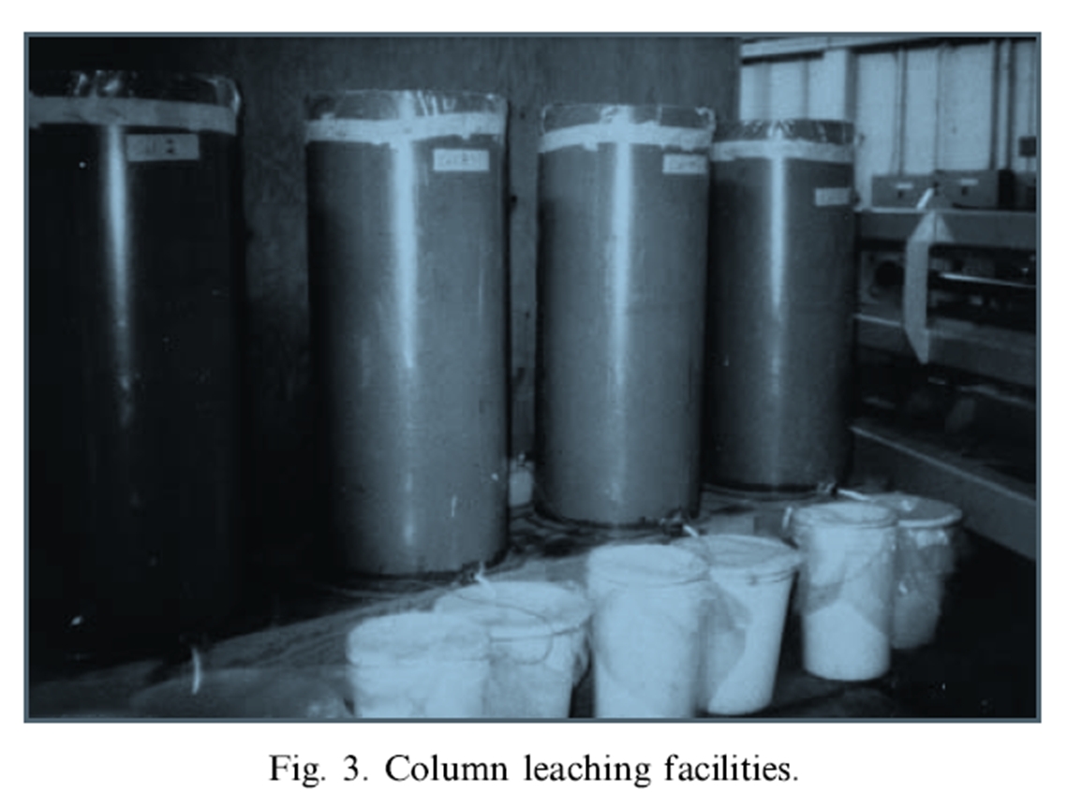


Slide 57
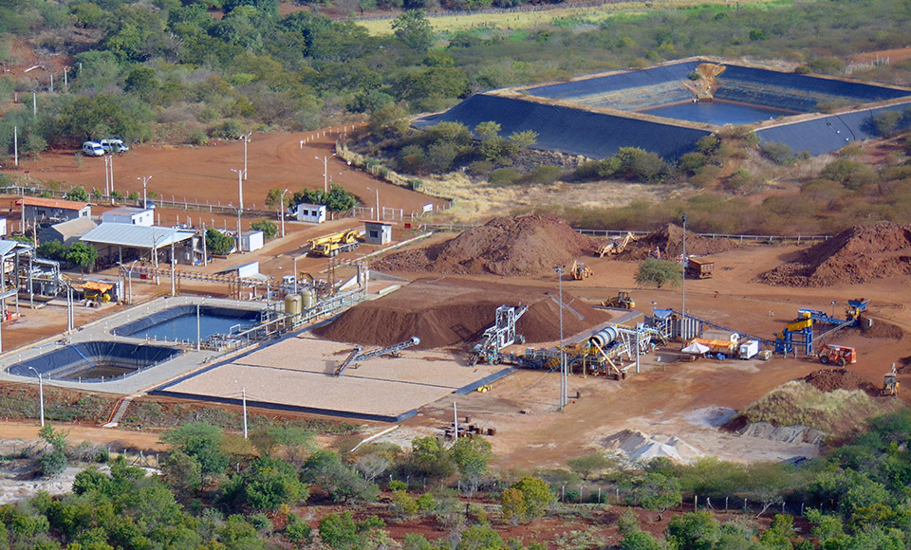
Industrial Leaching Process

Slide 58
Industrial Leaching Process
Heap leaching
Extract precious metals, copper, uranium, and other compounds from ore.
This procedure is mainly used for fine-grained ores.
Mined ore is usually crushed into small chunks.
Ore is arranged in heap.
Heap is subjected to continuous sprinkling of aqueous solution.
Aqueous solution contains microorganism.
Microorganism works on the heap of ore and produces leach liquor.

Slide 59
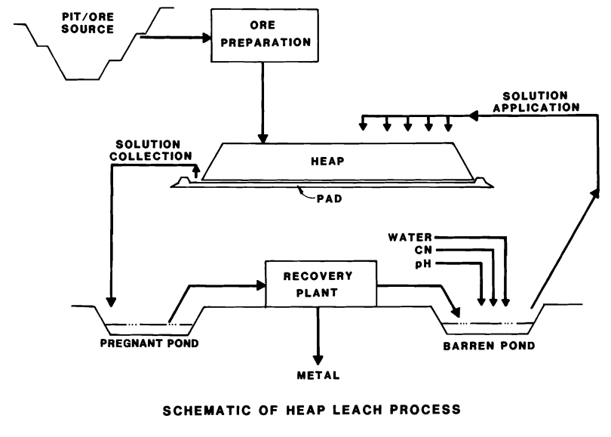
Heap leaching
Fig. 4: Schematic of Heap leaching process

Slide 60
Industrial Leaching Process
Dump leaching
An industrial process to extract precious metals and copper from ores.
Oldest process & similar to heap leaching.
Size of dump varies considerably.
Amount of ore in the range of several hundred thousand tons of ore.
This method of leaching is usually suitable for low grade ores because it is very low cost.
May take up about 1 to 2 years to extract 50% of the desired mineral.

Slide 61
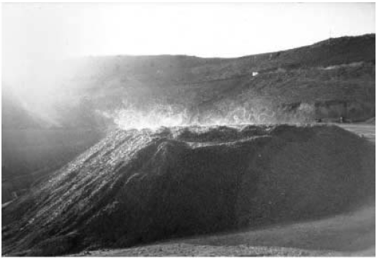
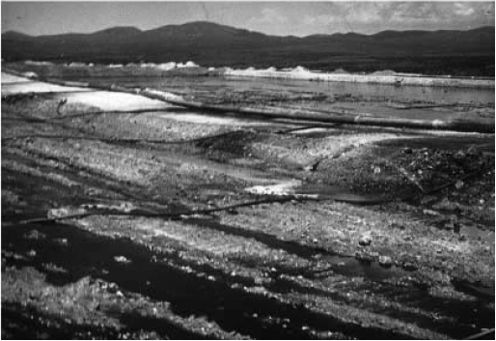
Dump leaching
The top of the dump is sprinkled continuously.(Fig. 5)
Or flooded temporarily.(Fig. 6)
Fig. 5
Fig. 6

Slide 62
Industrial Leaching Process
In situ leaching
Ore remains in its original position in earth.
Surface blasting of earth is done to increase the permeability of water.
Water containing thiobacillus is pumped through drilled passages to the ores.
Acidic water seeps through the rock & collects at bottom.
Again, water is pumped from bottom.
The leach liquid is collected at the of the ore used for metal extraction.

Slide 63
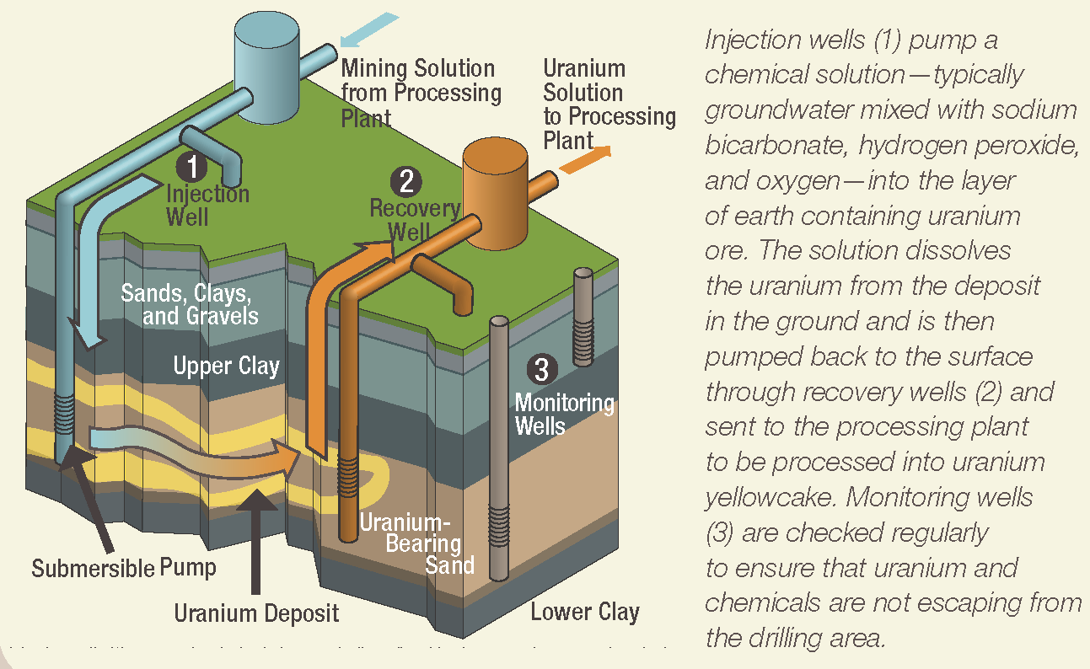
Fig. 7: In situ recovery process(uranium)

Slide 64
Industrial Leaching Process
Tank leaching
It was found to be most effective for the treatment of ore concentrates.
More than 80% of the total zinc was extracted from a zinc sulfide concentrate.
More expensive to construct and operate.
But the rate of metal extraction is much higher.
Currently, this technique is successfully used for bioleaching of refractory gold ores.

Slide 65
Tank leaching
In tank leaching the ground, classified solids are already mixed with water to form a slurry or pulp, and this is pumped into the tanks.
Leaching reagents are added to the tanks to achieve the leaching reaction.
In a continuous system the slurry will then either overflow from one tank to the next, or be pumped to the next tank.
Ultimately the “pregnant” solution (leach liquid) is separated from the slurry using some form of liquid/solid separation process, and the solution passes on to the next phase of recovery.

Slide 66
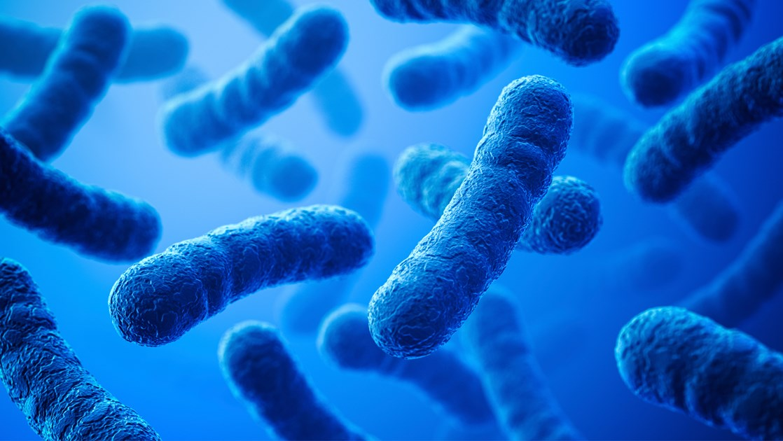
Applications of Bioleaching

Slide 67
Applications
Bioleaching is the extraction of metals from ores using the principal components of water, air and microorganisms, all of which are readily found within the environment.
With increase in industrialization along population growth, the demand of metals has increased and is likely to go up further in years to come.
During the last 25 years bioleaching of minerals has opened up new opportunities for extractive metallurgy.
At present copper, zinc, lead, nickel, gold, uranium are extracted by bioleaching process.

Slide 68
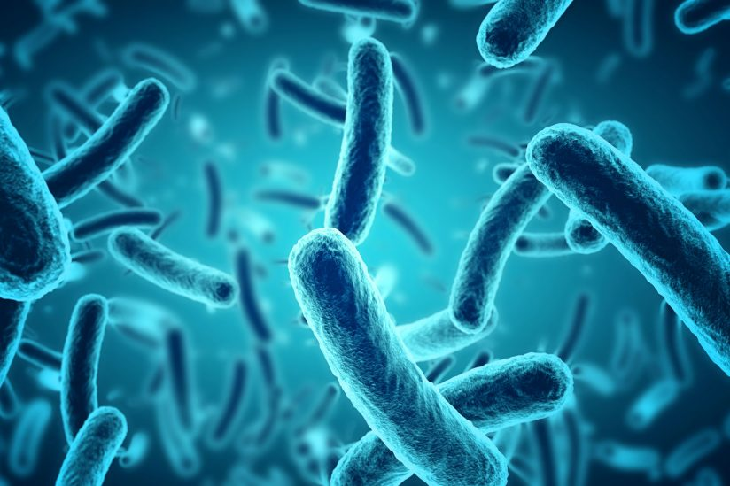
Bioleaching
of
Copper

Slide 69
Applications
Bioleaching of copper
Biological copper leaching is practiced in many countries including Australia, Canada, Chile, Mexico, Peru, Russia and the U.S.A.
Processing by smelting in most cases is not economical. So nowadays, bioleaching is used to extract copper from ore.
Copper recovery from bioleaching accounts for about 25% of the world copper production.
The physical configurations of bioleaching operations world wide for copper are mostly uniform.
Typically copper ore mined from open pits is segregated; higher grade metals is used for smelting and low grade ore is subjected to leaching.

Slide 70
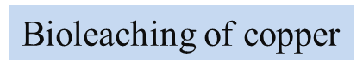
Applications
Applications
Year | Chile Thousand tons/yr | World | % Chilean Production
2002 | 4580.6 | 13565.4 | 33.8
2003 | 4904.2 | 13653.0 | 35.9
2004 | 5412.5 | 14681.0 | 36.9
2005 | 5320.5 | 15150.2 | 35.1
2006 | 5360.8 | 15180.6 | 35.3
2007 | 5557.0 | 15548.0 | 35.7
2008 | 5394.4 | 15695.0 | 33.9
2009 | 5148.9 | 15881.9 | 34.0
2010 | 5418.9 | 16134.4 | 33.6
2011 | 5262.8 | 16248.4 | 32.4

Slide 71
Applications
Bioleaching of copper
Although copper reserves and production are widely distributed around the world, no more than 15 countries contribute with over 90% of the total production Application of bioleaching to copper.
Chile occupies a privileged position with one third of the total world production as can be seen in Table.
It is worth noting that currently Chile produces over three times more copper than the second world producer, USA.

Slide 72
Applications
Bioleaching of copper
Ores of copper from which copper is recovered are,
Chalcocite(Cu₂S)
Chalcopyrite(CuFeS₂)
Covellite(CuS)
Copper leaching is operated as simple heap leaching and in-situ leaching process.

Slide 73
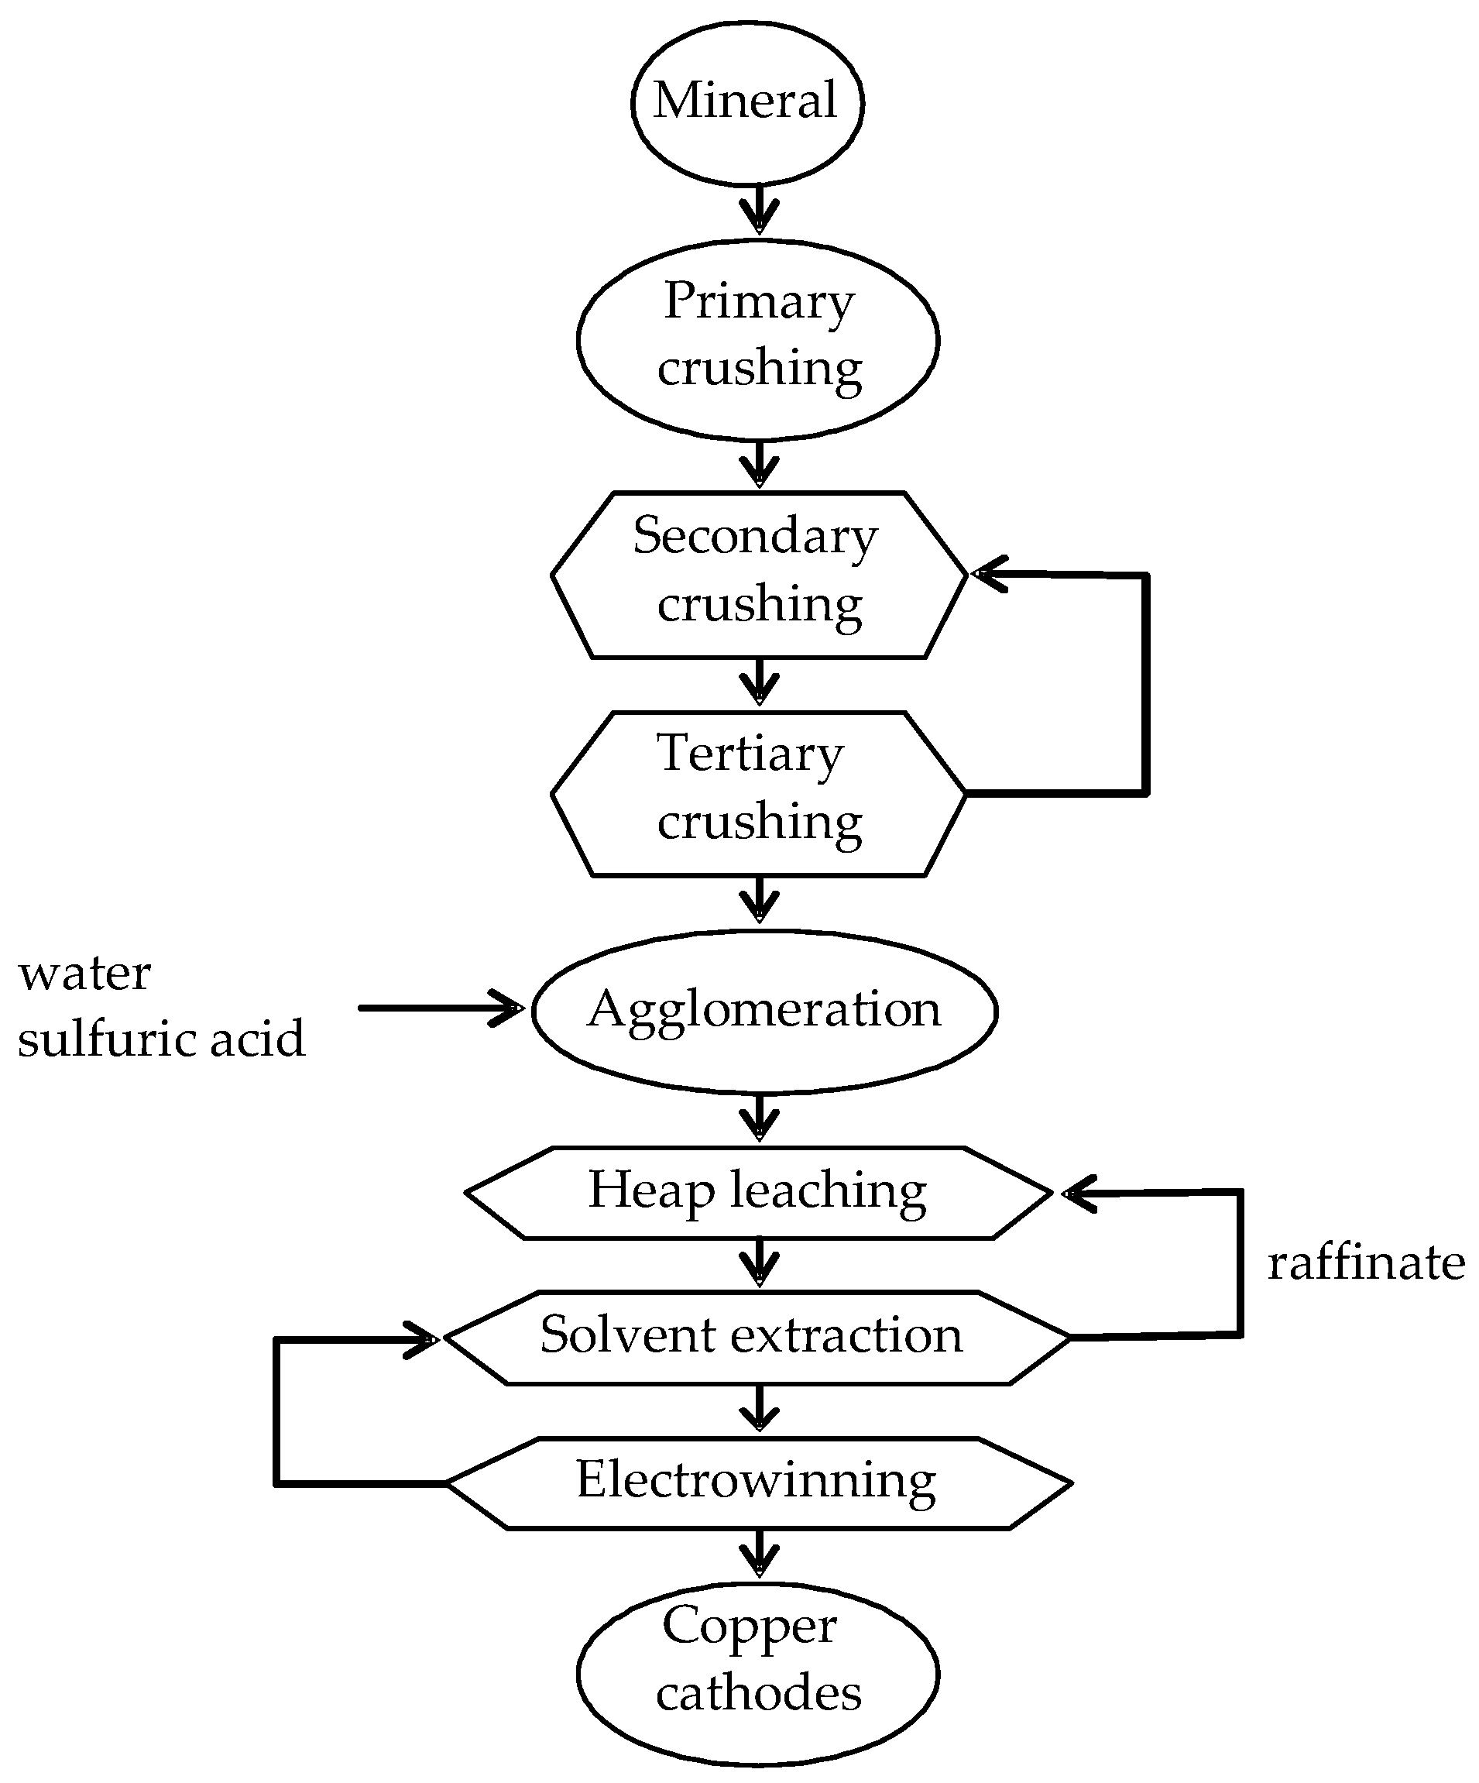
Applications
Flow Chart

Slide 74
Bioleaching
of
Uranium

Slide 75
Applications
Uranium is an important natural resource used for the generation of nuclear energy, as the raw material for the production of uranium oxide U₃O₈ .
Uranium is extracted conventionally using a process that employs strong acids as reagents, which often creates environmental problems, requires large amounts of energy, and involves a complex operational plant .
It is not economical to extract uranium from low-grade ores by chemical leaching because the content of uranium ore is very low by weight .
Bioleaching of low-grade ores is becoming a popular alternative since it is an economically viable phenomenon moreover the microorganisms used in these processes are able to grow in highly acidic environments with high heavy metal content (U and Th).

Slide 76
Applications
Bioleaching of Uranium
Acidithiobacillus ferrooxidans is used to leach U from the low-grade uranium ore.
The ferric ion acts as an electron acceptor and converts U⁺⁴ to U⁺⁶ state which is soluble in water, hence the metal is leached out to the liquor solution.
Reaction takes place:
UO₂ + Fe₂(SO₄)₃ UO₂SO₄ + 2FeSO₄
2FeSO₄ + 1/2O₂ + H₂SO₄ Fe₂(SO₄)₃ + H₂O
Therefore, efficiency of bioleaching depends on various parameters such as pulp density, initial pH, initial ferrous concentration, availability of oxygen.

Slide 77

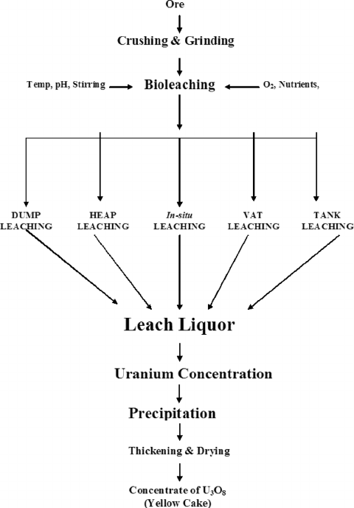
Applications
Flow Chart

Slide 78
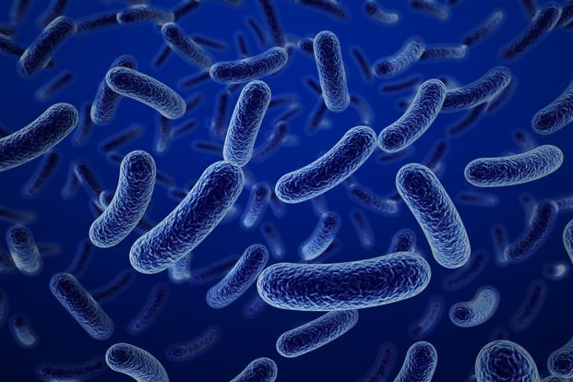
Bioleaching
of
zinc

Slide 79
Applications
Applications
Bioleaching of Zinc
According to International Zinc Association, the mining, smelting and refining of zine contributes US$ 18.5 billion to the world economy each year.
Over 25-30 years the zinc industry has moved away from traditional pyrometallurgy to hydrometallurgy.
Nowadays, about 80% of the total world’s zinc is produced through conventional hydrometallurgy methods(roast- leaching- electro-wining).
The main zinc mineral is sphalerite, which is degraded by acidophilic autotrophic bacteria through the polysulfide mechanism.

Slide 80
Applications
Applications
Bioleaching of Zinc
Several experiments on the bioleaching of sphalerite have been carried out using pure cultures or mixed cultures of iron-oxidizing and sulfur oxidizing bacteria
Comparisons between the different published results are difficult because the experiments were carried out using different culture conditions and temperatures
Bioleaching of sphalerite can be improved by using mixed cultures of bacteria
In experiments using 20% pulp density, zinc extraction as high as 84% was reached using a consortium of acidophilic chemo lithotrophic iron and sulfur-oxidizers heterotrophic organisms.

Slide 81
Conclusion
Bioleaching is considered today not only with respect to its ability to recover valuable metals. Further development is required with respect to both technical and biological aspects.
The latter includes increasing the rate of leaching and the tolerance of microorganisms to heavy metals.

Slide 82
Conclusion
Genetic improvement of bioleaching bacteria by mutation and selection or by genetic engineering will bring results faster than conventional procedures like screening and adaptation.

Slide 83


